Slide 1
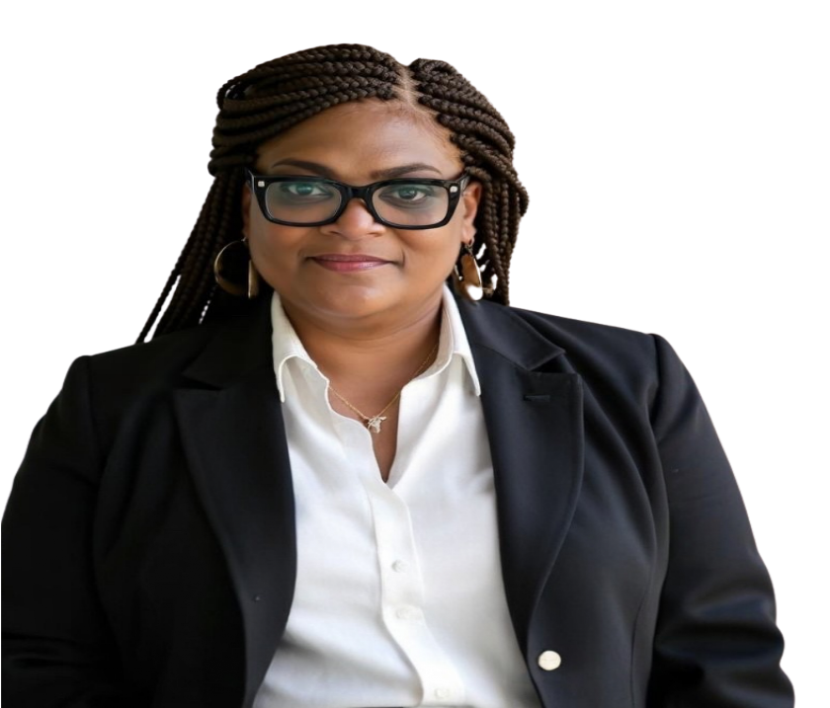

360 GUIDE
BOOK
August 2025 | Issue Number I
Governance Matters: How To Lead With Integrity
A GUIDE FOR NEW AND RETURNING BOARD MEMBERS
A gift from Novus Mundus 360 LLC
© 2025 Novus Mundus 360. All rights reserved.
This material may not be reproduced, distributed, or transmitted in any form or by any means, without prior written permission.

Slide 2
An Exclusive Excerpt from Our On-Demand Training
This workbook is an excerpt from the Novus Mundus 360 Governance Training, originally delivered live in August. It represents a sample of the complete training experience available through our
On-Demand platform and custom in-person board trainings.
Next Steps:
Contact us at info@novusmundus360.org to schedule a phone call or an in-person conversation
Sign up for On-Demand Training at novusmundus360.org to access the remaining chapters.
No portion of this workbook may be reproduced without prior written approval.
3

Slide 3

Novus Mundus 360
Governance Workbook — Section 1: Roles & Responsibilities
“The best way to predict the future is to create it.” — Peter Drucker

Slide 4
Table of Contents
Learning Objectives
What Governance Means
Why Governance Matters
Board Responsibilities
Board vs Superintendent/CEO
Governance Ecosystem
Effective Board Members
Self-Assessment Rubric
Governance Heat Map
Case Applications
Reflection Journal
Action Planning

Slide 5
Learning Objectives
By the end of this section, you will be able to:
Understand what governance means in education.
Explain the three main responsibilities of a nonprofit board.
Differentiate governance vs. management roles.
Identify qualities of effective board members.
Apply explicit knowledge (laws, codes) and tacit insights (experience, instincts).

Slide 6
What Governance Means
Governance is the leadership and oversight function of the board. It protects the mission, ensures fiscal integrity, and maintains compliance with law and policy. Management runs daily operations; governance sets direction and holds the system accountable.
Reflection — Explicit & Tacit
Explicit: Define governance in one sentence.
Tacit: Recall a time when poor oversight caused problems. What did you notice first?
________________________________________________________________________________________________________________________________________________________________________________________________________________________________________________________________________________________________________________________________________________________________________________________________________________________________________________________________________________________________________________________________________________________________________________________________________________________________________________________________________________________________________________________________________________________________________________________________________________________________________________________________________________________________________________________________________________________________________________________________________________________________________________________________________________________________________________________________________________________________________________________________________________________________________________________________________________________________________________________________________________________________________________________________________________________________________________________________________________________________________________________________________________________________________________________________________________________________________________________________________________________________________________________________________________________________________________________________________________________________________________________________________________________________________________________________________________________________________________________________________________________________________________________________________________________________________________________________________________________

Slide 7
Board Responsibilities
Set Direction — Define mission, vision, and goals.
Oversee Finances — Approve budgets, review reports, safeguard public funds.
Ensure Compliance — Follow laws, bylaws, and regulations.
Reflection — Explicit & Tacit
Explicit: Which of these duties are written into law or bylaws?
Tacit: Which duty feels most natural to you, and why?
____________________________________________________________________________________________________________________________________________________________________________________________________________________________________________________________________________________________________________________________________________________________________________________________________________________________________________________________________________________________________________________________________________________________________________________________________________________________________________________________________________________________________________________________________________________________________________________________________________________________________________________________________________________________________________________________________________________________________________________________________________________________________________________________________________________________________________________________________________________________________________________________________________________________________________________________________________________________________________________________________________________________________________________________________________________________________________________________________________________________________________________________________________________________________________________________________________________________________________________________________________________________________________________________________________________________________________________________________________________________________________________________________________________________________________________________________________________________________________________________________________________________________________________________________________________________________________________________________________________________________________________________________________________________________________________________________________________________

Slide 8
Board vs Superintendent/CEO
Board (Governance): sets the what and why.
Establishes mission and vision.
Approves policy.
Oversees financial integrity.
Ensures legal and charter compliance.
Superintendent/CEO (Management): leads the how.
Runs daily operations.
Hires and supervises staff.
Leads curriculum and instruction.
Engages families and students.
Boards ask: “Are we doing the right things?” Leaders ask: “Are we doing things right?”
Reflection — Explicit & Tacit
Explicit: Which duties are mandated by law?
Tacit: When have you seen these roles blur? What were the consequences?
__________________________________________________________________________________________________________________________________________________________________________________________________________________________________________________________________________________________________________________________________________________________________________________________________________________________________________________________________________________________________________________________________________________________________________________________________________________________________________________________________________________________________________________________________________________________________________________________________________________________________________________________________________________________________________________________________________________________________________________________________________________________________________________________________________________________________________________________________________________________________________________________________________________________________________________________________________________________________________

Slide 9
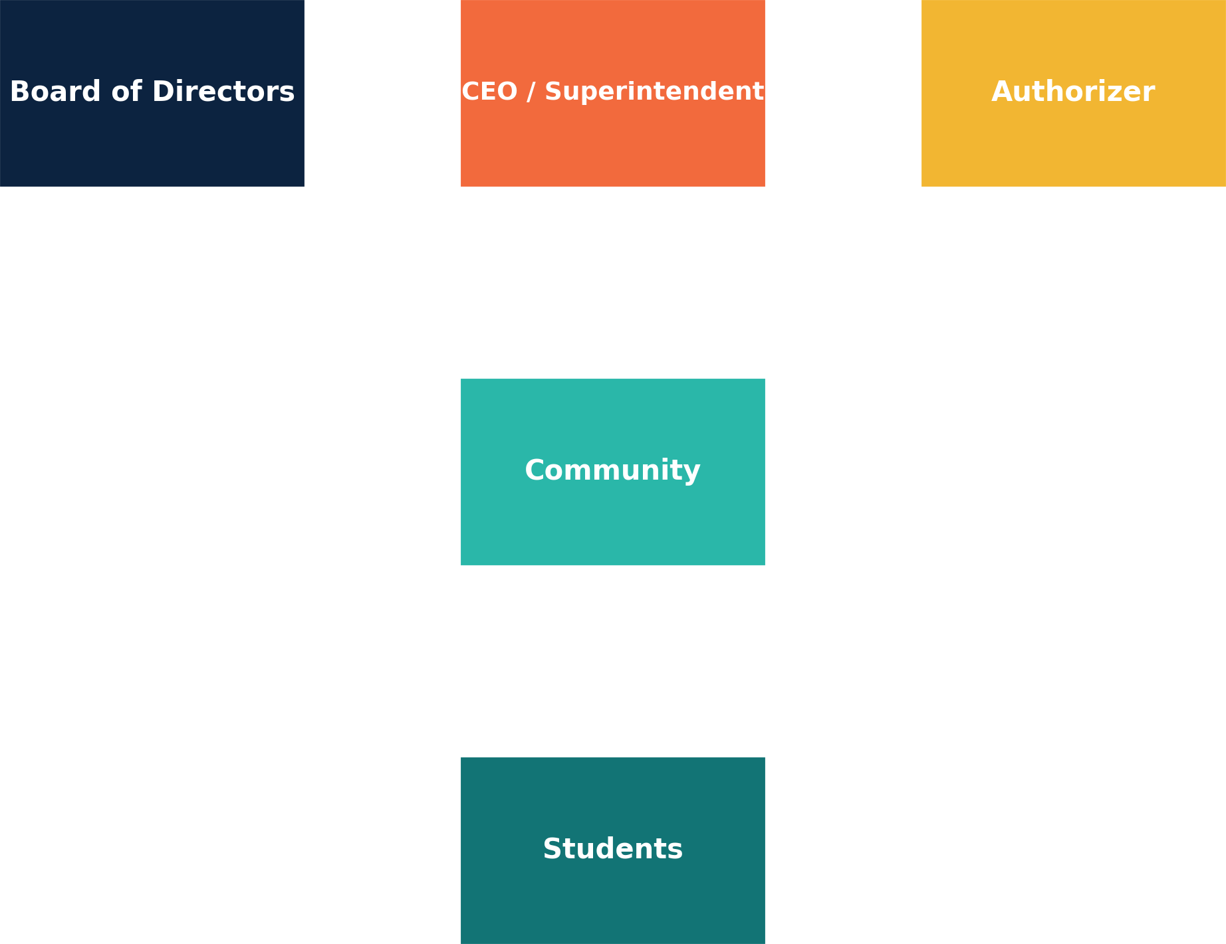
Governance Ecosystem
Boards, CEOs, Authorizers, Communities, and Students influence and check one another. Understanding this ecosystem prevents overreach and neglect.
Reflection — Explicit & Tacit
Explicit: Which stakeholders have formal authority over your board?
Tacit: How do community or student voices shape decisions?
____________________________________________________________________________________________________________________________________________________________________________________________________________________________________________________________________________________________________________________________________________________________________________________________________________________________________________________________________________________________________________________________________________________________________________________________________________________________________________________________________________________________________________________________________________________________________________________________________________________________________________________________________________________________________________________________________________________________________________________________________________________________________________________________________________________________________________________________________________________________________________________________________________________________________________________________________________________________________________________________________________________________________________________________________________________________________________________________________________________________________________________________________________________________

Slide 10
Effective Board Members
Prepares thoroughly for meetings (reads materials in advance).
Asks thoughtful, mission-centered questions.
Puts students and mission first over personal preferences.
Respects boundaries between governance and management.
Models integrity, honesty, and transparency.

Slide 11
Self-Assessment Rubric
Habit | Novice | Developing | Proficient | Expert
Preparation | Rarely reviews materials | Sometimes reviews in advance | Consistently prepared | Anticipates issues proactively
Questioning | Asks few questions | Asks surface-level questions | Asks thoughtful questions | Shapes board dialogue with inquiry
Mission-focus | Focus on own views | Sometimes student-first | Always student-first | Champions mission system-wide

Slide 12
Governance Heat Map
Governance Area | Confidence (1–5) | Impact (1–5)
Finance Oversight | ■1 ■2 ■3 ■4 ■5 | ■1 ■2 ■3 ■4 ■5
Compliance | ■1 ■2 ■3 ■4 ■5 | ■1 ■2 ■3 ■4 ■5
Mission & Strategy | ■1 ■2 ■3 ■4 ■5 | ■1 ■2 ■3 ■4 ■5
Community Engagement | ■1 ■2 ■3 ■4 ■5 | ■1 ■2 ■3 ■4 ■5

Slide 13
Case Application 1
The CEO signs a vendor contract without informing the board. The board learns after the fact.
Reflection — Explicit & Tacit
Explicit: Which bylaws or policies apply?
Tacit: What instincts guide your response?
________________________________________________________________________________________________________________________________________________________________________________________________________________________________________________________________________________________________________________________________________________________________________________________________________________________________________________________________________________________________________________________________________________________________________________________________________________________________________________________________________________________________________________________________________________________________________________________________________________________________________________________________________________________________________________________________________________________________________________________________________________________________________________________________________________________________________________________________________________________________________________________________________________________________________________________________________________________________________________________________________________________________________________________________________________________________________________________________________________________________________________________________________________________________________________________________________________________________________________________________________________________________________________________________________________________________________________________________________________________________________________________________________________________________________________________________________________________________________________________________________________________________________________________________________________________________________________________________________________________________________________________________________________________________________________________________________________________________________________________________________________________________________________________________________________________________________________________________________________________________________________________________________________________________________________________________________________________________________________________________________________________________________________________________________________________________________
__________________________________________________________________________

Slide 14
Case Application 2
The board debates cutting a program to balance the budget; some argue it violates the school mission.
Reflection — Explicit & Tacit
Explicit: Which fiduciary duties are implicated?
Tacit: How do you weigh mission and finances?
________________________________________________________________________________________________________________________________________________________________________________________________________________________________________________________________________________________________________________________________________________________________________________________________________________________________________________________________________________________________________________________________________________________________________________________________________________________________________________________________________________________________________________________________________________________________________________________________________________________________________________________________________________________________________________________________________________________________________________________________________________________________________________________________________________________________________________________________________________________________________________________________________________________________________________________________________________________________________________________________________________________________________________________________________________________________________________________________________________________________________________________________________________________________________________________________________________________________________________________________________________________________________________________________________________________________________________________________________________________________________________________________________________________________________________________________________________________________________________________________________________________________________________________________________________________________________________________________________________________________________________________________________________________________________________________________________________________________________________________________________________________________________________________________________________________________________________________________________________________________________________________________________________________________________________________________________________________________________________________________________________________________________________________________________________________________________

Slide 15
Reflection Journal
Explicit: List three governance principles or codes that guide your board.
Tacit: Describe a leadership instinct that has served you well in complex situations.
______________________________________________________________________________________________________________________________________________________________________________________________________________________________________________________________________________________________________________________________________________________________________________________________________________________________________________________________________________________________________________________________________________________________________________________________________________________________________________________________________________________________________________________________________________________________________________________________________________________________________________________________________________________________________________________________________________________________________________________________________________________________________________________________________________________________________________________________________________________________________________________________________________________________________________________________________________________________________________________________________________________________________________________________________________________________________________________________________________________________________________________________________________________________________________________________________________________________________________________________________________________________________________________________________________________________________________________________________________________________________________________________________________________________________________________________________________________________________________________________________________________________________________________________________________________________________________

Slide 16
Action Planning
Explicit: Name three governance skills you will strengthen this quarter.
Tacit: Identify one instinct you will refine, and how you will practice it.
“Integrity is doing the right thing, even when no one is watching.” — Maya Angelou
_________________________________________________________________________________________________________________________________________________________________________________________________________________________________________________________________________________________________________________________________________________________________________________________________________________________________________________________________________________________________________________________________________________________________________________________________________________________________________________________________________________________________________________________________________________________________________________________________________________________________________________________________________________________________________________________________________________________________________________________________________________________________________________________________________________________________________________________________________________________________________________________________________________________________________________________________________________________________________________________________________________________________________________________________________________________________________________________________________________________________________________________________________________________________________________________________________________________________________________________________________________________________________________________________________________________________________________________________________________________________________________________________________________________________________________________________________________________________________________________________________________________________________________________________________________________________________

Slide 17
Novus Mundus 360
Governance Workbook — Section 2: Fiduciary Duties & Integrity
“Integrity is the essence of everything successful.” — R. Buckminster Fuller

Slide 18
Table of Contents
Learning Objectives
The Three Fiduciary Duties
Integrity in Action
California Governance Laws
California Practice Scenario
Texas Governance Laws
Texas Practice Scenario
Nevada Governance Laws
Nevada Practice Scenario
PRODE Framework
Application Worksheet
Reflection Journal
Closing Notes

Slide 19
Learning Objectives
Define fiduciary duties in plain language.
Recognize examples of duty of care, loyalty, and obedience.
Explain why integrity is central to governance and public trust.
Reflection — Explicit & Tacit
Explicit: Write a one-sentence definition for each duty.
Tacit: When did your instincts tell you a decision was right or wrong, even before discussion?
________________________________________________________________________________________________________________________________________________________________________________________________________________________________________________________________________________________________________________________________________________________________________________________________________________________________________________________________________________________________________________________________________________________________________________________________________________________________________________________________________________________________________________________________________________________________________________________________________________________________________________________________________________________________________________________________________________________________________________________________________________________________________________________________________________________________________________________________________________________________________________________________________________________________________________________________________________________________________________________________________________________________________________________________________________________________________________________________________________________________________________________________________________________________________________________________________________________________________________________________________________________________________________________________________________________________________________________________________________________________________________

Slide 20
The Three Fiduciary Duties
Duty of Care: Do your homework before deciding. Example: Review the budget before approval.
Duty of Loyalty: Put the school first, not yourself. Example: Avoid pushing contracts that benefit your own business.
Duty of Obedience: Follow the mission and the rules. Example: Spend funds only in ways that benefit students.
Reflection — Explicit & Tacit
Explicit: State one action that demonstrates each duty.
Tacit: Which duty do you most rely on when the pressure is high? Why?
________________________________________________________________________________________________________________________________________________________________________________________________________________________________________________________________________________________________________________________________________________________________________________________________________________________________________________________________________________________________________________________________________________________________________________________________________________________________________________________________________________________________________________________________________________________________________________________________________________________________________________________________________________________________________________________________________________________________________________________________________________________________________________________________________________________________________________________________________________________________________________________________________________________________________________________________________________________________________________________________________________________________________________________________________________________________________________________________________________________________________________________________________________________________________________________________________________________________________________________________________________________________________________________________________________________________________________________________________________________________________________

Slide 21
Integrity in Action
Integrity means doing the right thing under pressure. Board members are stewards of trust and funds; every decision should withstand public scrutiny.
Reflection — Explicit & Tacit
Explicit: List two practices that increase transparency.
Tacit: Describe a time you did the right thing even when it was hard. What guided you?
________________________________________________________________________________________________________________________________________________________________________________________________________________________________________________________________________________________________________________________________________________________________________________________________________________________________________________________________________________________________________________________________________________________________________________________________________________________________________________________________________________________________________________________________________________________________________________________________________________________________________________________________________________________________________________________________________________________________________________________________________________________________________________________________________________________________________________________________________________________________________________________________________________________________________________________________________________________________________________________________________________________________________________________________________________________________________________________________________________________________________________________________________________________________________________________________________________________________________________________________________________________________________________________________________________________________________________________________________________________________________________________________________

Slide 22
California Governance Laws
Corporations Code §§5210–5238 — Directors must act with care and in good faith.
Education Code §47605 — Charter boards must comply with all laws and ensure funds are used properly.
Brown Act — Board meetings must be open and noticed publicly.
Education Code §41020 — All spending must directly benefit students.

Slide 23
California Practice Scenario
Scenario: The board holds a closed-door meeting without public notice.
Answer: The Brown Act is violated.
Notes:

Slide 24
Texas Governance Laws
Business Organizations Code Ch.22 — Directors owe duties of care and loyalty.
Education Code Ch.12 — Charter boards must maintain financial transparency.
Government Code Ch.2256 — Public funds must follow strict investment rules.
Open Meetings Act Ch.551 — All deliberations must be open and transparent.

Slide 25
Texas Practice Scenario
Scenario: A charter school board invests funds in risky stocks without a policy.
Answer: Government Code Ch.2256 is violated.
Notes:
_________________________________________________________________________________________________________________________________________________________________________________________________________________________________________________________________________________________________________________________________________________________________________________________________________________________________________________________________________________________________________________________________________________________________________________________________________________________________________________________________________________________________________________________________________________________________________________________________________________________________________________________________________________________________________________________________________________________________________________________________________________________________________________________________________________________________________________________________________________________________________________________________________________________________________________________________________________________________________________________________________________________________________________________________________________________________________________________________________________________________________________________________________________________________________________________________________________________________________________________________________________________________________________________________________________________________________

Slide 26
Nevada Governance Laws
NRS Ch.82 — Directors must act in good faith and with prudence.
NRS 386.490–610 — Charters must meet governance and reporting requirements.
NRS 241 — Meetings must comply with open meeting law.
NRS 387.1241 — All public education funds must be properly accounted for.

Slide 27
Nevada Practice Scenario
Scenario: A charter school fails to file accurate financial reports.
Answer: NRS 387.1241 is violated.
Notes:
_________________________________________________________________________________________________________________________________________________________________________________________________________________________________________________________________________________________________________________________________________________________________________________________________________________________________________________________________________________________________________________________________________________________________________________________________________________________________________________________________________________________________________________________________________________________________________________________________________________________________________________________________________________________________________________________________________________________________________________________________________________________________________________________________________________________________________________________________________________________________________________________________________________________________________________________________________________________________________________________________________________________________________________________________________________________________________________________________________________________________________________________________________________________________________________________________________________________________________________________________________________________________________________________________________________________________________

Slide 28
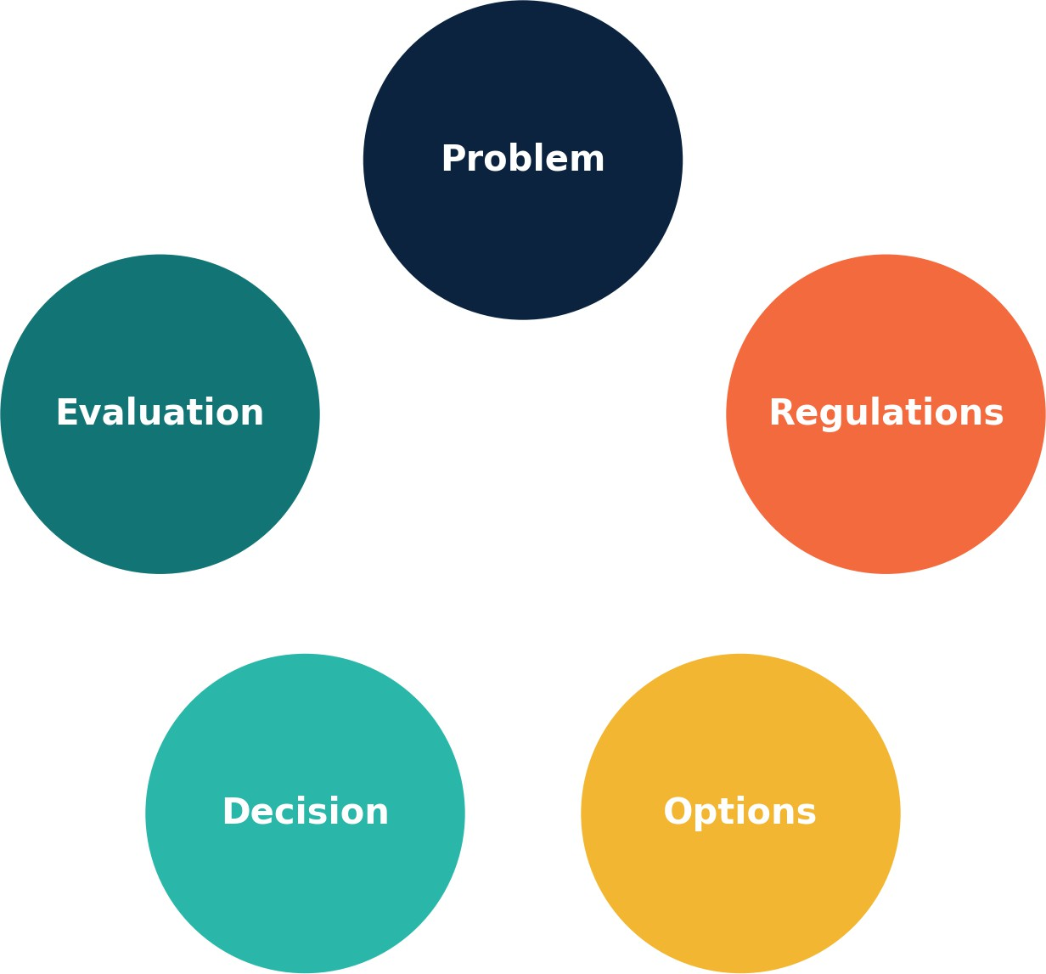
PRODE Framework
The PRODE framework structures decision-making:
Problem — Define the issue clearly.
Regulations — Identify relevant laws or codes.
Options — List possible choices.
Decision — Select the best path.
Evaluation — Review outcomes and adjust.

Slide 29
Application Worksheet
Choose a recent board decision. How did the fiduciary duties of care, loyalty, and obedience apply? Use PRODE to analyze the decision.
Notes:
________________________________________________________________________________________________________________________________________________________________________________________________________________________________________________________________________________________________________________________________________________________________________________________________________________________________________________________________________________________________________________________________________________________________________________________________________________________________________________________________________________________________________________________________________________________________________________________________________________________________________________________________________________________________________________________________________________________________________________________________________________________________________________________________________________________________________________________________________________________________________________________________________________________________________________________________________________________________________________________________________________________________________________________________________________________________________________________________________________________________________________________________________________________________________________________________________________________________________________________________________________________________________________________________________________________________________________________________________________________________________________________________________________________________________________________________________________________________________

Slide 30
Reflection Journal
Explicit: Why is integrity especially important in educational governance?
Tacit: How would you explain fiduciary duties to a new board member using your own experience?
_____________________________________________________________________________________________________________________________________________________________________________________________________________________________________________________________________________________________________________________________________________________________________________________________________________________________________________________________________________________________________________________________________________________________________________________________________________________________________________________________________________________________________________________________________________________________________________________________________________________________________________________________________________________________________________________________________________________________________________________________________________________________________________________________________________________________________________________________________________________________________________________________________________________________________________________________________________________________________________________________________________________________________________________________________________________________________________________________________________________________________________________________________________________________________________________________________________________________________________________________________________________________________________________________________________________________________________________________________________________________________________________________________________________________________________________________________________________________________________________________________________________________________________________________________________________________________________________________________________________________________________________________________

Slide 31
Closing Notes
“Education is the most powerful weapon which you can use to change the world.” — Nelson
Mandela
Which law or duty from this section most protects students in your view, and why?

Slide 32
Novus Mundus 360
Governance Workbook — Section 3: Case Studies
“Tell me and I forget, teach me and I may remember, involve me and I learn.” — Benjamin
Franklin

Slide 33
Table of Contents
Learning Objectives
Case Study 1: Horizon Academy Audit (Parts 1–3)
Case Study 2: Bright Futures Academy Dilemma (Parts 1–4)
Case Studies Reflection Activity
Reflection Journal
Closing Notes

Slide 34
Learning Objectives
Analyze governance failures using real-world style scenarios.
Identify which fiduciary duties and laws were violated.
Design corrective actions to restore trust and compliance.
Reflection — Explicit & Tacit
Explicit: Name two duties you expect to analyze in a case.
Tacit: How do you learn best from mistakes—your own or others’?
________________________________________________________________________________________________________________________________________________________________________________________________________________________________________________________________________________________________________________________________________________________________________________________________________________________________________________________________________________________________________________________________________________________________________________________________________________________________________________________________________________________________________________________________________________________________________________________________________________________________________________________________________________________________________________________________________________________________________________________________________________________________________________________________________________________________________________________________________________________________________________________________________________________________________________________________________________________________________________________________________________________________________________________________________________________________________________________________________________________________________________________________________________________________________________________________________________________________________________________________________________________________________________________________________________________________________________________________________________________________________________

Slide 35
Case Study 1: Horizon Academy Audit (Part 1)
Horizon Academy’s board approved $2.3 million in travel and consultants. Auditors found missing receipts and no link to student benefit.
Reflection — Explicit & Tacit
Explicit: What questions should the board have asked?
Tacit: How would your instincts react if you saw this pattern?
_______________________________________________________________________________________________________________________________________________________________________________________________________________________________________________________________________________________________________________________________________________________________________________________________________________________________________________________________________________________________________________________________________________________________________________________________________________________________________________________________________________________________________________________________________________________________________________________________________________________________________________________________________________________________________________________________________________________________________________________________________________________________________________________________________________________________________________________________________________________________________________________________________________________________________________________________________________________________________________________________________________________________________________________________________________________________________________________________________________________________________________________________________________________________________________________________________________________________________________________________________________________________________________________________________________

Slide 36
Case Study 1: Horizon Academy Audit (Part 2)
Stakeholder Voices:
Parents: 'Why is money going to trips instead of classrooms?'
Teachers: 'We lack supplies while funds are spent on consultants.'
Regulators: 'This spending violates requirements for documentation.'
Taxpayers: 'Public funds should be used for students, not perks.'
Practice: Which fiduciary duties were violated? Which California laws apply?

Slide 37
Case Study 1: Horizon Academy Audit (Analysis)
Duty of Care: Board failed to review documentation before approval.
Duty of Loyalty: Consultant interests may have been prioritized.
Duty of Obedience: Funds not aligned with education codes.
Corrective Actions:
Require receipts and justification for all expenses.
Publish transparent financial reports.
Provide fiduciary duty training to board members.

Slide 38
Case Study 2: Bright Futures Academy Dilemma (Part 1)
Bright Futures faced a budget shortfall. Some trustees proposed cutting arts, others argued it betrayed the mission.
Reflection — Explicit & Tacit
Explicit: How would cutting arts impact stakeholders?
Tacit: Have you faced a conflict between finances and mission? How did it feel?
________________________________________________________________________________________________________________________________________________________________________________________________________________________________________________________________________________________________________________________________________________________________________________________________________________________________________________________________________________________________________________________________________________________________________________________________________________________________________________________________________________________________________________________________________________________________________________________________________________________________________________________________________________________________________________________________________________________________________________________________________________________________________________________________________________________________________________________________________________________________________________________________________________________________________________________________________________________________________________________________________________________________________________________________________________________________________________________________________________________________________________________________________________________________________________________________________________________________________________________________________________________________________________________________________

Slide 39
Case Study 2: Bright Futures Academy Dilemma (Part 2)
Stakeholder Perspectives:
Students: 'The arts keep us engaged and creative.'
Parents: 'We chose this school for holistic education.'
Teachers: 'Arts are essential for well-rounded education.'
Board Members: 'We must balance finances with mission fidelity.'
Practice: Which fiduciary duty is at risk if arts are cut? (Answer: Duty of Obedience)

Slide 40
Case Study 2: Bright Futures Academy Dilemma (Applying PRODE)
Use the PRODE framework:
Problem: Budget shortfall.
Regulations: State laws on program requirements.
Options: Cut arts, raise funds, reduce elsewhere.
Decision: Choose mission- and compliance-aligned path.
Evaluation: Monitor student impact and finances.
Reflection — Explicit & Tacit
Explicit: Which option best balances mission and money?
Tacit: How could you reframe this as a win-win?
__________________________________________________________________________________________________________________________________________________________________________________________________________________________________________________________________________________________________________________________________________________________________________________________________________________________________________________________________________________________________________________________________________________________________________________________________________________________________________________________________________________________________________________________________________________________________________________________________________________________________________________________________________________________________________________________________________________________________________________________________________________________________________________________________________________________________________________________________________________________________________________________________________________________________________________________________________________________________________________________________________________________________________________________________________________________________________________________________________________________________________________________________________________________________________________________________________________________________________________________________________________________________________________

Slide 41
Case Study 2: Bright Futures Academy Dilemma (Analysis)
Duty of Care: Trustees must carefully weigh options.
Duty of Loyalty: Avoid advancing personal agendas.
Duty of Obedience: Stay true to holistic mission.
Corrective Actions:
Explore creative funding solutions.
Seek community partnerships for arts.
Use PRODE to document the decision process.

Slide 42
Case Studies Reflection Activity
What mistakes did the boards make?
How could you prevent those mistakes as a board member?
What questions should always be asked before financial decisions?
____________________________________________________________________________________________________________________________________________________________________________________________________________________________________________________________________________________________________________________________________________________________________________________________________________________________________________________________________________________________________________________________________________________________________________________________________________________________________________________________________________________________________________________________________________________________________________________________________________________________________________________________________________________________________________________________________________________________________________________________________________________________________________________________________________________________________________________________________________________________________________________________________________________________________________________________________________________________________________________________________________________________________________________________________________________________________________________________________________________________________________________________________________________________________________________________________________________________________________________________________________________________________________________________________________________________________________________________________________________________________________________________________________________________________________________________________________________________________________________________________________________________________________________________________________________________________________________________________________________________________________________________________________________________________________________________________________________________________________________________________________________________________________________________________________________________________________________________________________________________________________________________________________________________________________________________________________________________________________________________________________________________________________________________________________________________________________________________________________________________________________________________________________________________________________________________

Slide 43
Reflection Journal
Explicit: What duty or law did you learn most about through these cases?
Tacit: What leadership instinct do you want to sharpen as a result?
_________________________________________________________________________________________________________________________________________________________________________________________________________________________________________________________________________________________________________________________________________________________________________________________________________________________________________________________________________________________________________________________________________________________________________________________________________________________________________________________________________________________________________________________________________________________________________________________________________________________________________________________________________________________________________________________________________________________________________________________________________________________________________________________________________________________________________________________________________________________________________________________________________________________________________________________________________________________________________________________________________________________________________________________________________________________________________________________________________________________________________________________________________________________________________________________________________________________________________________________________________________________________________________________________________________________________________________________________________________________________________________________________________________________________________________________________________________________________________________________________________________________________________________________________________________________________________________________________________________________________________________________________________________________________________________________________________________________________________________________________________________________________________________________________________________________________________________________________________________________________________________________________________________________________________________________________________________________________________________________________________________________________________________________________________________________________________________________________________________________________________________________________________________

Slide 44
Closing Notes
“An investment in knowledge pays the best interest.” — Benjamin Franklin
Write one lesson from these cases you will carry into your own governance practice.
__________________________________________________________________________________________________________________________________________________________________________________________________________________________________________________________________________________________________________________________________________________________________________________________________________________________________________________________________________________________________________________________________________________________________________________________________________________________________________________________________________________________________________________________________________________________________________________________________________________________________________________________________________________________________________________________________________________________________________________________________________________________________________________________________________________________________________________________________________________________________________________________________________________________________________________________________________________________________________________________________________________________________________________________________________________________________________________________________________________________________________________________________________________________________________________________________________________________________________________________________________________________________________________________________________________________________________________________________________________________________________________________________________________________________________________________________________________________________________________________________________________________________________________________________________________________________________________________________________________________________________________________________________________________________________________________________________________________________________________________________________

Slide 45
Novus Mundus 360
Governance Workbook — Section 4: Outside Influences & Frameworks
“Leadership is not about being in charge. It is about taking care of those in your charge.” —
Simon Sinek

Slide 46
Table of Contents
Learning Objectives
Outside Influences: Parents & Community
Outside Influences: Triangulation & Agendas
Conflicts Between Beliefs & Mission
PRIDE Framework
Applying PRIDE
PRODE Framework
Applying PRODE
GEAR Framework
Applying GEAR
Reflection Activity
Reflection Journal
Closing Notes

Slide 47
Learning Objectives
Recognize outside influences and how they affect governance.
Use PRIDE to develop policies.
Apply PRODE to structure tough decisions.
Use GEAR to measure explicit and tacit learning.
Reflection — Explicit & Tacit
Explicit: Name one outside influence you must manage.
Tacit: How do you sense when external pressure is distorting governance?
_____________________________________________________________________________________________________________________________________________________________________________________________________________________________________________________________________________________________________________________________________________________________________________________________________________________________________________________________________________________________________________________________________________________________________________________________________________________________________________________________________________________________________________________________________________________________________________________________________________________________________________________________________________________________________________________________________________________________________________________________________________________________________________________________________________________________________________________________________________________________________________________________________________________________________________________________________________________________________________________________________________________________________________________________________________________________________________________________________________________________________________________________________________________________________________________________________________________________________________________________________________________________________________________________________________________________________________________________

Slide 48
Outside Influences: Parents & Community
Board members often hear directly from parents and community. Listening matters, but boards cannot bypass grievance processes or act on rumors.
Best Practice: Thank the person, direct them to grievance policy, avoid promises.
Reflection — Explicit & Tacit
Explicit: Which policies guide handling complaints?
Tacit: How do you show empathy without overstepping?
_______________________________________________________________________________________________________________________________________________________________________________________________________________________________________________________________________________________________________________________________________________________________________________________________________________________________________________________________________________________________________________________________________________________________________________________________________________________________________________________________________________________________________________________________________________________________________________________________________________________________________________________________________________________________________________________________________________________________________________________________________________________________________________________________________________________________________________________________________________________________________________________________________________________________________________________________________________________________________________________________________________________________________________________________________________________________________________________________________________________________________________________________________________________________________________________________________________________________________________________________________________________________________________________________________________

Slide 49
Outside Influences: Triangulation & Agendas
Triangulation happens when individuals share info with one board member privately to sway decisions. This undermines transparency. Advocacy groups and unions may also push agendas; boards must align decisions to mission and law.
Reflection — Explicit & Tacit
Explicit: What laws require open deliberation?
Tacit: How can you respond when someone tries to triangulate you?
_______________________________________________________________________________________________________________________________________________________________________________________________________________________________________________________________________________________________________________________________________________________________________________________________________________________________________________________________________________________________________________________________________________________________________________________________________________________________________________________________________________________________________________________________________________________________________________________________________________________________________________________________________________________________________________________________________________________________________________________________________________________________________________________________________________________________________________________________________________________________________________________________________________________________________________________________________________________________________________________________________________________________________________________________________________________________________________________________________________________________________________________________________________________________________________________________________________________________________________________________________________________________________________________________________________________________________________________________________________

Slide 50
Conflicts Between Beliefs & Mission
Sometimes board members’ personal beliefs clash with mission. Fiduciary duty requires putting mission first.
Example: A trustee may undervalue arts but must support them if central to mission.
Reflection — Explicit & Tacit
Explicit: How do bylaws safeguard mission fidelity?
Tacit: Recall a time you set aside a belief for mission. How did it feel?
________________________________________________________________________________________________________________________________________________________________________________________________________________________________________________________________________________________________________________________________________________________________________________________________________________________________________________________________________________________________________________________________________________________________________________________________________________________________________________________________________________________________________________________________________________________________________________________________________________________________________________________________________________________________________________________________________________________________________________________________________________________________________________________________________________________________________________________________________________________________________________________________________________________________________________________________________________________________________________________________________________________________________________________________________________________________________________________________________________________________________________________________________________________________________________________________________________________________________________

Slide 51
PRIDE Framework
Purpose — Why is this policy needed?
Research — What laws or best practices apply?
Inclusive Development — Who should provide input?
Documentation — Write clear, specific policies.
Education — Train everyone on the policy.

Slide 52
Applying PRIDE
Example: Conflict of Interest Policy
Purpose: Ensure decisions are not self-serving.
Research: Review nonprofit codes.
Inclusive Development: Include legal counsel and staff.
Documentation: Spell out procedures.
Education: Train board annually.
Notes:
_______________________________________________________________________________________________________________________________________________________________________________________________________________________________________________________________________________________________________________________________________________________________________________________________________________________________________________________________________________________________________________________________________________________________________________________________________________________________________________________________________________________________________________________________________________________________________________________________________________________________________________________________________________________________________________________________________________________________________________________________________________________________________________________________________________________________________________________________________________________________________________________________________________________________________________________________________________________________________________________________________________________________________________________________________________________________

Slide 53
PRODE Framework
Problem — Define the issue clearly.
Regulations — Identify relevant laws or codes.
Options — List possible choices.
Decision — Select the best path.
Evaluation — Review outcomes and adjust.

Slide 54
Applying PRODE
Example: Deciding Whether to Close a Program
Problem: Program costs exceed budget.
Regulations: State laws on requirements.
Options: Cut program, reduce costs, seek funding.
Decision: Choose mission- and compliance-aligned path.
Evaluation: Assess student and financial impact.
Reflection — Explicit & Tacit
Explicit: Which option balances finance and mission?
Tacit: How do your instincts guide you in such dilemmas?
____________________________________________________________________________________________________________________________________________________________________________________________________________________________________________________________________________________________________________________________________________________________________________________________________________________________________________________________________________________________________________________________________________________________________________________________________________________________________________________________________________________________________________________________________________________________________________________________________________________________________________________________________________________________________________________________________________________________________________________________________________________________________________________________________________________________________________________________________________________________________________________________________________________________________________________________________________________________________________________________________________________________________________________________________________________________________________________________________________________________________________________________________________________________________________________________________________________________________________________________________________________________

Slide 55
GEAR Framework
Gather — Collect knowledge.
Engage — Apply it in real scenarios.
Assess — Rate growth in confidence and skills.
Reflect — Plan forward and improve.

Slide 56
Applying GEAR
Example: Board Training Session
Gather: Learn fiduciary duties.
Engage: Work through case study.
Assess: Rate knowledge from 1–10 before/after.
Reflect: Write one improvement step.
Notes:
_____________________________________________________________________________________________________________________________________________________________________________________________________________________________________________________________________________________________________________________________________________________________________________________________________________________________________________________________________________________________________________________________________________________________________________________________________________________________________________________________________________________________________________________________________________________________________________________________________________________________________________________________________________________________________________________________________________________________________________________________________________________________________________________________________________________________________________________________________________________________________________________________________________________________________________________________________________________________________________________________________________________________________________________________________________________________________________________________________________________________________________________________________________

Slide 57
Reflection Activity
How might outside influences impact board integrity?
Which framework (PRIDE, PRODE, GEAR) do you find most practical? Why?
How can frameworks support difficult decisions?
______________________________________________________________________________________________________________________________________________________________________________________________________________________________________________________________________________________________________________________________________________________________________________________________________________________________________________________________________________________________________________________________________________________________________________________________________________________________________________________________________________________________________________________________________________________________________________________________________________________________________________________________________________________________________________________________________________________________________________________________________________________________________________________________________________________________________________________________________________________________________________________________________________________________________________________________________________________________________________________________________________________________________________________________________________________________________________________________________________________________________________________________________________________________________________________________________________________________________________________________________________________________________
__________________________________________________________________________________________________________________________________________________________________________________________________________________________________________________________________________________________________________________________________________________________________________________________________________________________________________________________________________________________________________________________________________________________________________________________________________________________________________________________________________________________________________________________________________________________________________________________________________________________________________________________________________________________________________________

Slide 58
Reflection Journal
Explicit: Write one framework step you will apply immediately.
Tacit: Write about a time when outside influence shaped your decision-making.
________________________________________________________________________________________________________________________________________________________________________________________________________________________________________________________________________________________________________________________________________________________________________________________________________________________________________________________________________________________________________________________________________________________________________________________________________________________________________________________________________________________________________________________________________________________________________________________________________________________________________________________________________________________________________________________________________________________________________________________________________________________________________________________________________________________________________________________________________________________________________________________________________________________________________________________________________________________________________________________________________________________________________________________________________________________________________________________________________________________________________________________________________________________________________________________________________________________________________________________________________________________________________________________________
________________________________________________________________________________________________________________________________________________________________________________________________________________________________________________________________________________________________________________________________________________________________________________________________________________________________________________________________________________________________________________________________________________________________________________________________________________________________________________________________________________________________________________________________________________________________________________________________________________________________________________________________________________________________________________________________

Slide 59
Closing Notes
“Leadership is about vision and responsibility, not power.”
Which tool from this section will be most valuable to your governance role?
________________________________________________________________________________________________________________________________________________________________________________________________________________________________________________________________________________________________________________________________________________________________________________________________________________________________________________________________________________________________________________________________________________________________________________________________________________________________________________________________________________________________________________________________________________________________________________________________________________________________________________________________________________________________________________________________________________________________________________________________________________________________________________________________________________________________________________________________________________________________________________________________________________________________________________________________________________________________________________________________________________________________________________________________________________________________________________________________________________________________________________________________________________________________________________________________________________________________________________________________________________________________________________
_____________________________________________________________________________________________________________________________________________________________________________________________________________________________________________________________________________________________________________________________________________________________________________________________________________________________________________________________________________________________________________________________________________________________________________________________________________________________________________________________________________________________________________________________________________________________________________________________________________________________________________________________________________________________________________________

Slide 60
Novus Mundus 360
Governance Workbook
Section 5: Communication & Integrity in Action
“The most powerful leadership tool you have is your own personal example.”
— John Wooden
© 2025 Novus Mundus 360. All rights reserved.
This material may not be reproduced, distributed, or transmitted in any form or by any means, without the prior written permission of Novus Mundus 360.

Slide 61
Table of Contents
Learning Objectives
Integrity and Communication Best Practices
Assessment (Part 1)
Assessment (Part 2)
Answer Key (Part 1)
Answer Key (Part 2)
Now What? Takeaways & Commitments
Reflection & Notes (Angelou)
Reflection & Notes (Emerson)
Reflection & Notes (Mandela)
About Novus Mundus 360
Continue Your Journey (On-Demand CTA)

Slide 62
Learning Objectives
Describe how to communicate effectively as a board member.
Distinguish between governance and micromanagement.
Apply integrity to board communication and decision-making.

Slide 63
Integrity and Communication
Board members must communicate with respect and clarity. Within the board, disagreements should remain professional, and unity should be shown once a decision is made. With the Superintendent/CEO, communication must focus on oversight and partnership, not micromanagement.
Listen actively before responding.
Speak with respect, even in disagreement.
Support decisions publicly once made.
Ask clarifying questions instead of giving commands.
Use the three-question tool: Is it true? Is it necessary? Is it respectful?

Slide 64
Assessment (Part 1)
Name the three fiduciary duties.
Which California law requires open meetings?
Which Texas law governs investment of public funds?
Which Nevada law requires reporting of education funds?
What should a board do if a parent shares stories about the principal?

Slide 65
Assessment (Part 2)
Apply PRODE to a decision about cutting sports programs.
What does integrity mean in governance?
Give one example of triangulation and how to avoid it.
Why should boards not micromanage the Superintendent?
What does GEAR measure in learning?

Slide 66
Answer Key (Part 1)
Duty of Care, Duty of Loyalty, Duty of Obedience.
The Brown Act.
Government Code Chapter 2256.
NRS 387.1241.
Listen respectfully, direct to the grievance process, and avoid side-taking.

Slide 67
Answer Key (Part 2)
PRODE: Problem (funding gap), Regulations (laws), Options (cut/reduce/fundraise), Decision, Evaluation.
Integrity means honesty, transparency, and acting in the best interest of students and mission.
Triangulation = one-on-one attempts to sway a board member. Avoid by redirecting to open discussion.
Micromanagement undermines the CEO. Boards govern; CEOs manage.
GEAR measures explicit knowledge (what you can state) and tacit knowledge (judgment and instincts).

Slide 68
Now What? Takeaways & Commitments
Boards guide, leaders manage.
Fiduciary duties ensure accountability.
State laws protect transparency and student benefit.
Frameworks (PRIDE, PRODE, GEAR) provide practical tools.
Integrity and communication build trust and sustainability. Commitment: Write three actions you will take as a result of this chapter.
__________________________________________________________________________________________________________________________________________________________________________________________________________________________________________________________________________________________________________________________________________________________________________________________________________________________________________________________________________________________________________________________________________________________________________________________________________________________________________________________________________________________________________________________________________________________________________________________________________________________________________________________________________________________________________________________________________________________________________________________________________________________________________________________________________________________________________________________________________________________________________________________________________________________________________________________________________________________________________________________________________________________________________________________________________________________________________________________________________________________________________________________________________________________________________________________________________________________________________________________________________________________________________________

Slide 69
“Integrity is doing the right thing, even when no one is watching.” — Maya Angelou
Prompt: What’s one action I can take to model integrity in my role?
___________________________________________________________________________________________________________________________________________________________________________________________________________________________________________________________________________________________________________________________________________________________________________________________________________________________________________________________________________________________________________________________________________________________________________________________________________________________________________________________________________________________________________________________________________________________________________________________________________________________________________________________________________________________________________________________________________________________________________________________________________________________________________________________________________________________________________________________________________________________________________________________________________________________________________________________________________________________________________________________________________________________________________________________________________________________________________________________________________________________________________________________________________________________________________________________________________________________________________________________________________________________________________________________________________________________________________________________________________________________________________________________________________________________________________________________________________________________________________________________________________________________________________________________________________________________________________________________________________________________________________________________________________________________________________________________________________________________________________________________________________________________________________________________________________________________________________________________________________________________________________________________________________________________________________________________________________________________________________________________________________________________________________________________________________________________________________________________________________________________________________________________________________________________________________________________________________________________________________________________________________________________________________________________________________________________________________________________________________________________________________________________________

Slide 70
“Do not follow where the path may lead. Go instead where there is no path and leave a
trail.” — Ralph Waldo Emerson
Prompt: What new trail can I help my board create?
__________________________________________________________________________________________________________________________________________________________________________________________________________________________________________________________________________________________________________________________________________________________________________________________________________________________________________________________________________________________________________________________________________________________________________________________________________________________________________________________________________________________________________________________________________________________________________________________________________________________________________________________________________________________________________________________________________________________________________________________________________________________________________________________________________________________________________________________________________________________________________________________________________________________________________________________________________________________________________________________________________________________________________________________________________________________________________________________________________________________________________________________________________________________________________________________________________________________________________________________________________________________________________________________________________________________________________________________________________________________________________________________________________________________________________________________________________________________________________________________________________________________________________________________________________________________________________________________________________________________________________________________________________________________________________________________________________________________________________________________________________________________________________________________________________________________________________________________________________________________________________________________________________________________________________________________________________________________________________________________________________________________________________________________________________________________________________________________________________________________________________________________________________________________________________________________________________________________________________________________________________________________________________________________________________________________________________________________________________________________

Slide 71
“Education is the most powerful weapon which you can use to change the world.” — Nelson Mandela
Prompt: How can my governance decisions advance equity and opportunity?
__________________________________________________________________________________________________________________________________________________________________________________________________________________________________________________________________________________________________________________________________________________________________________________________________________________________________________________________________________________________________________________________________________________________________________________________________________________________________________________________________________________________________________________________________________________________________________________________________________________________________________________________________________________________________________________________________________________________________________________________________________________________________________________________________________________________________________________________________________________________________________________________________________________________________________________________________________________________________________________________________________________________________________________________________________________________________________________________________________________________________________________________________________________________________________________________________________________________________________________________________________________________________________________________________________________________________________________________________________________________________________________________________________________________________________________________________________________________________________________________________________________________________________________________________________________________________________________________________________________________________________________________________________________________________________________________________________________________________________________________________________________________________________________________________________________________________________________________________________________________________________________________________________________________________________________________________________________________________________________________________

Slide 72
About Novus Mundus 360
Making the world a better place, one board at a time.
Who We Are: Novus Mundus 360 partners with schools, boards, and education leaders to strengthen governance, improve compliance, and build organizational health.
Our Mission: Strong governance transforms communities. By equipping boards with tools, training, and frameworks, we help ensure that every decision supports student success, equity, and sustainability.
What We Do:
Board training & development
Charter renewal and compliance guidance
Leadership coaching for CEOs and Superintendents
Policy design & strategic planning
Conflict resolution and stakeholder engagement
Who We Serve: Charter schools, small districts, independent and faith-based schools, and education nonprofits across multiple states.
Contact Us: novusmundus360.org | info@novusmundus360.org

Slide 73

Continue Your Journey with Novus Mundus 360
Sign up today for our On-Demand Training and unlock access to the remaining chapters of this
Governance Workbook series.
Scan to visit:
novusmundus360.org
nfo@novusmundus360.org
1-916-277-8431
“Strong governance transforms communities.”

